Slide 1

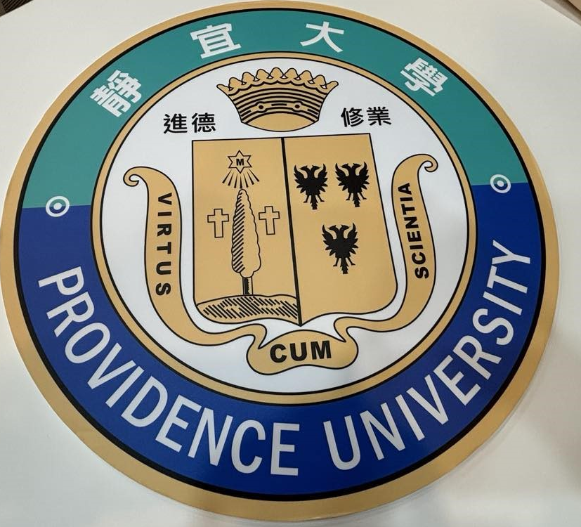
TRIP TO THE REPUBLIC OF CHINA
PROVIDENCE UNIVERSITY YING YI

Slide 2
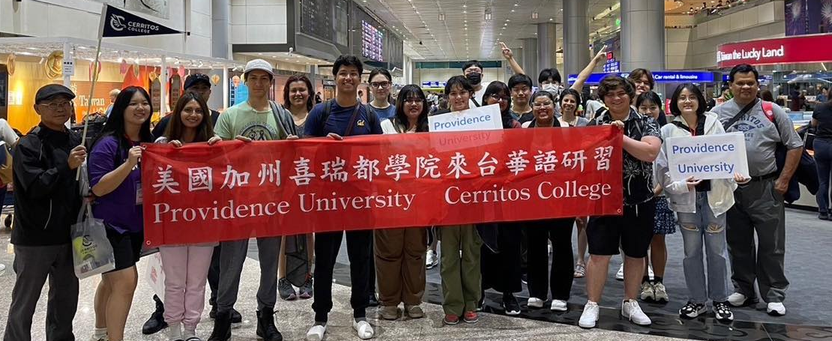
WE ARRIVED TO TAOYUAN AIRPORT AND THE STUDENTS OF THE UNIVERSITY OF PROVIDENCE WERE WAITING FOR US FOR ONE HOUR TRIP TO TAICHUNG.

Slide 3
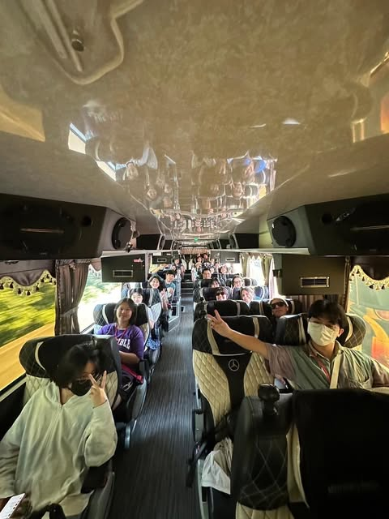
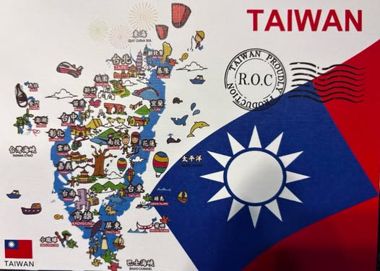
WE WERE TRANSPORTED FROM THE AIRPORT TO TAICHUNG CITY WICH IS LOCATED IN THE SOUTH WEST OF THE ISLAND.

Slide 4
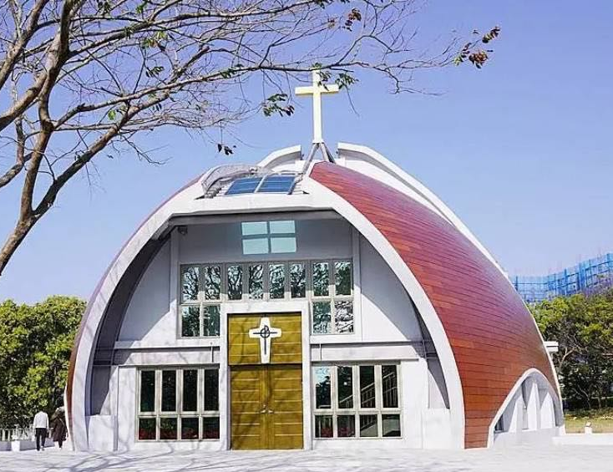
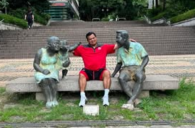
U12 Consortium: They are 12 private Universities sharing academic resources., and is one of two Taiwan universities participating in the ISEP network. ( Internation Student Exchange Program)
Providence University was founded by an American congregation, the Sisters of Providence of Saint Mary-of-the-Woods (Indiana, United States).
In 1948, the Chinese Civil War forced the sisters to retreat first to Shanghai and later to Taiwan.
In July 1989, it was renamed the "Providence University for Women". In 1993, it assumed its current name "Providence University", and began to enroll male students

Slide 5
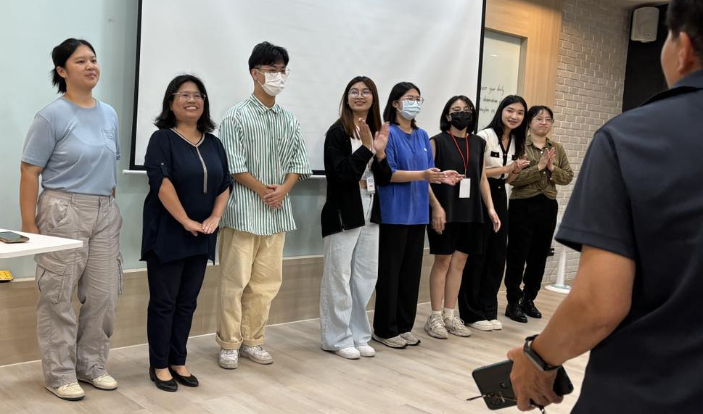
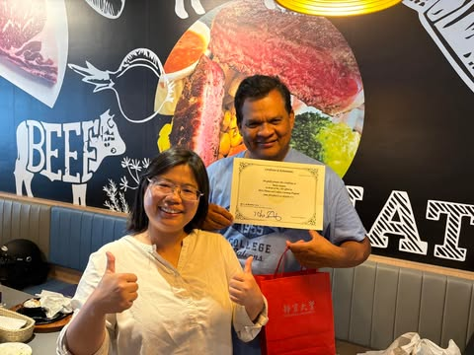
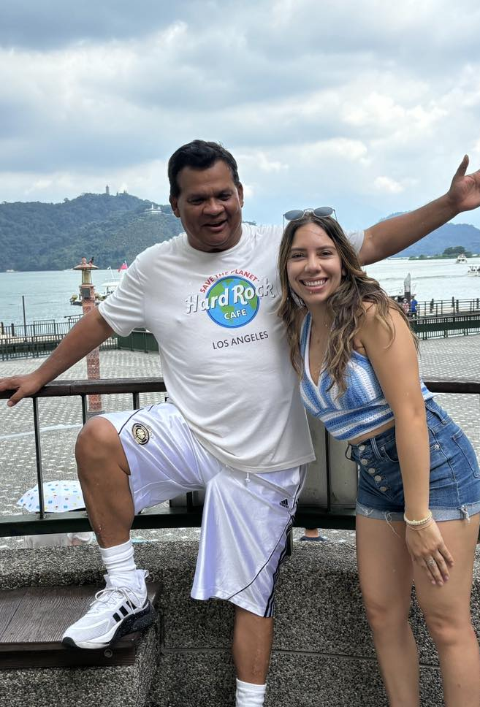
WE RECEIVED MANDARING CLASSES IN THE MORNING FROM 8 :00 AM TO 12:00. AND IN THE AFTERNOON, THERE WERE ACTIVITIES LIKE MARTIAL ARTS, CHINESE SEAL STAMP, CALLIGRAPHY, TEA DRINKING CULTURE, AND MANY MORE ACTIVITIES. ON THE WEEKENDS WERE OUT OF TOWN EXCURSIONS: SOON MOO LAKE, LUKANG, ETC.

Slide 6
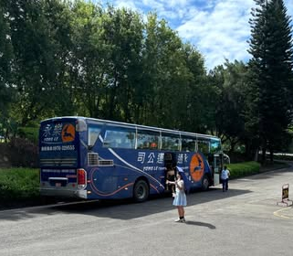
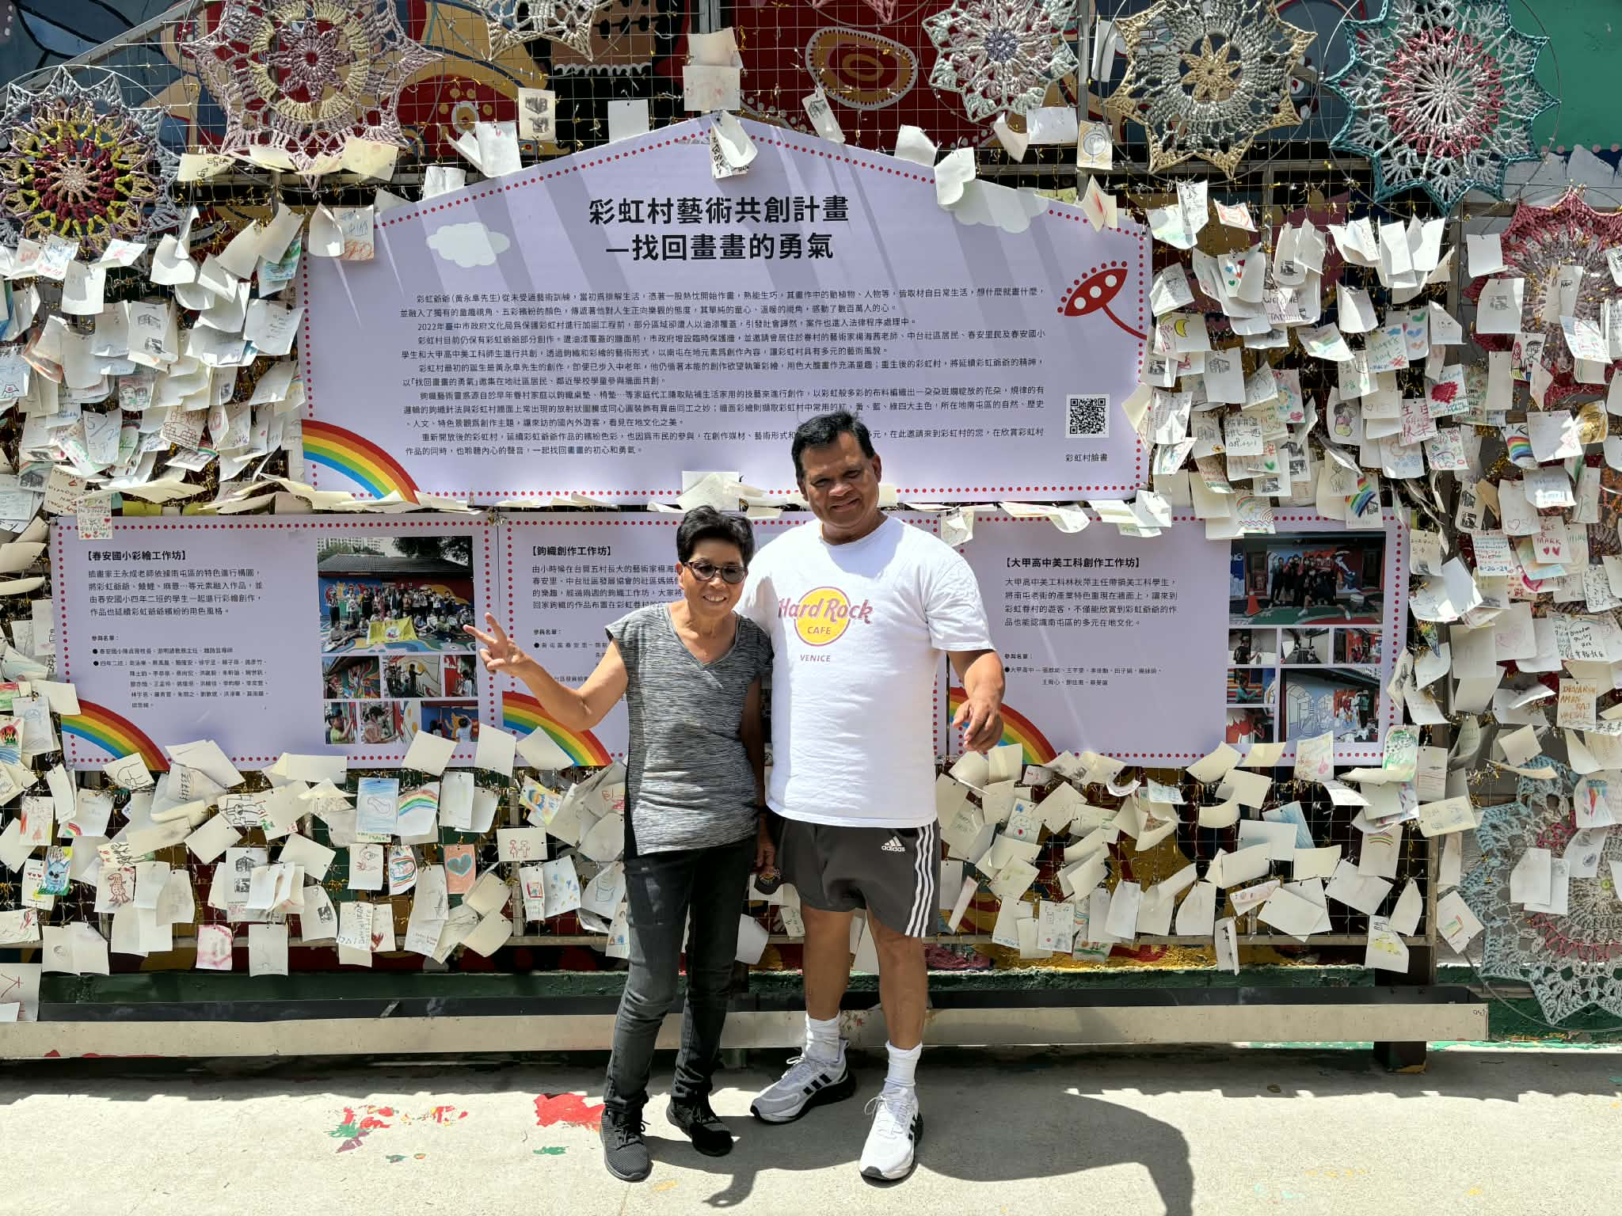
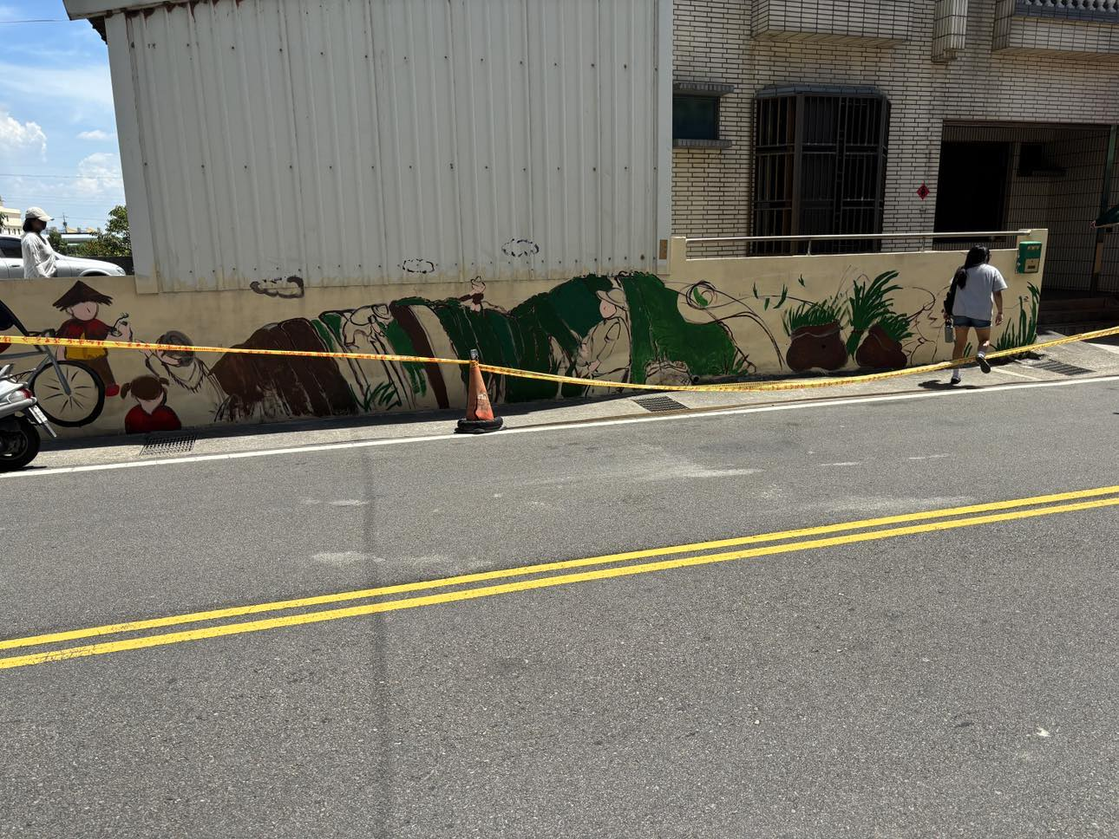
WE VISITED MANY PLACES IN TAICHUNG FOR THE APPRECIATION OF UNIQUE TAIWAN CULTURE ALSO THEY HAVE ONE DAY FOR THE APPRECIATION OF THE AMERICAN CULTURE EXPLAINED TO THE TAIWANESE STUDENTS.

Slide 7
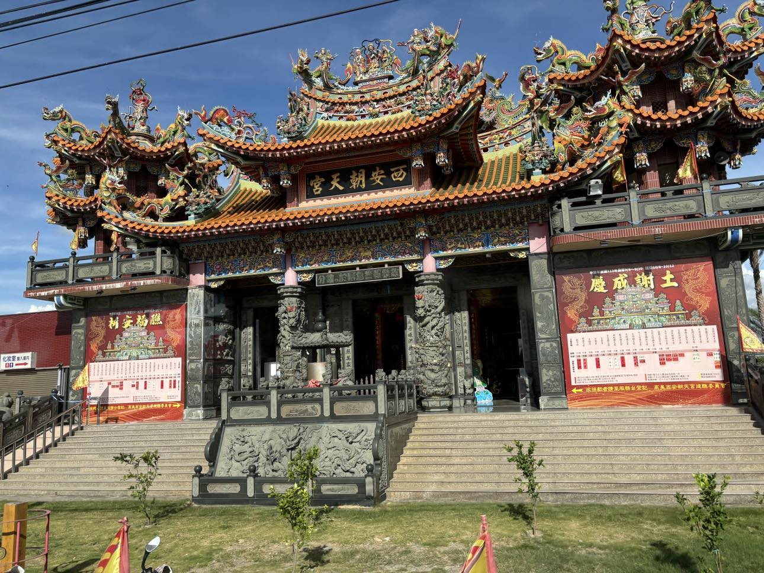
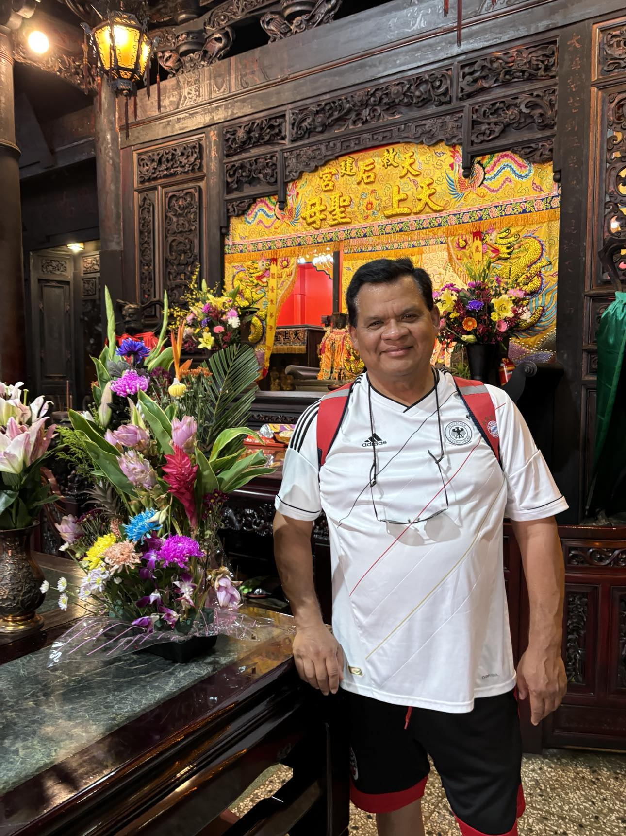
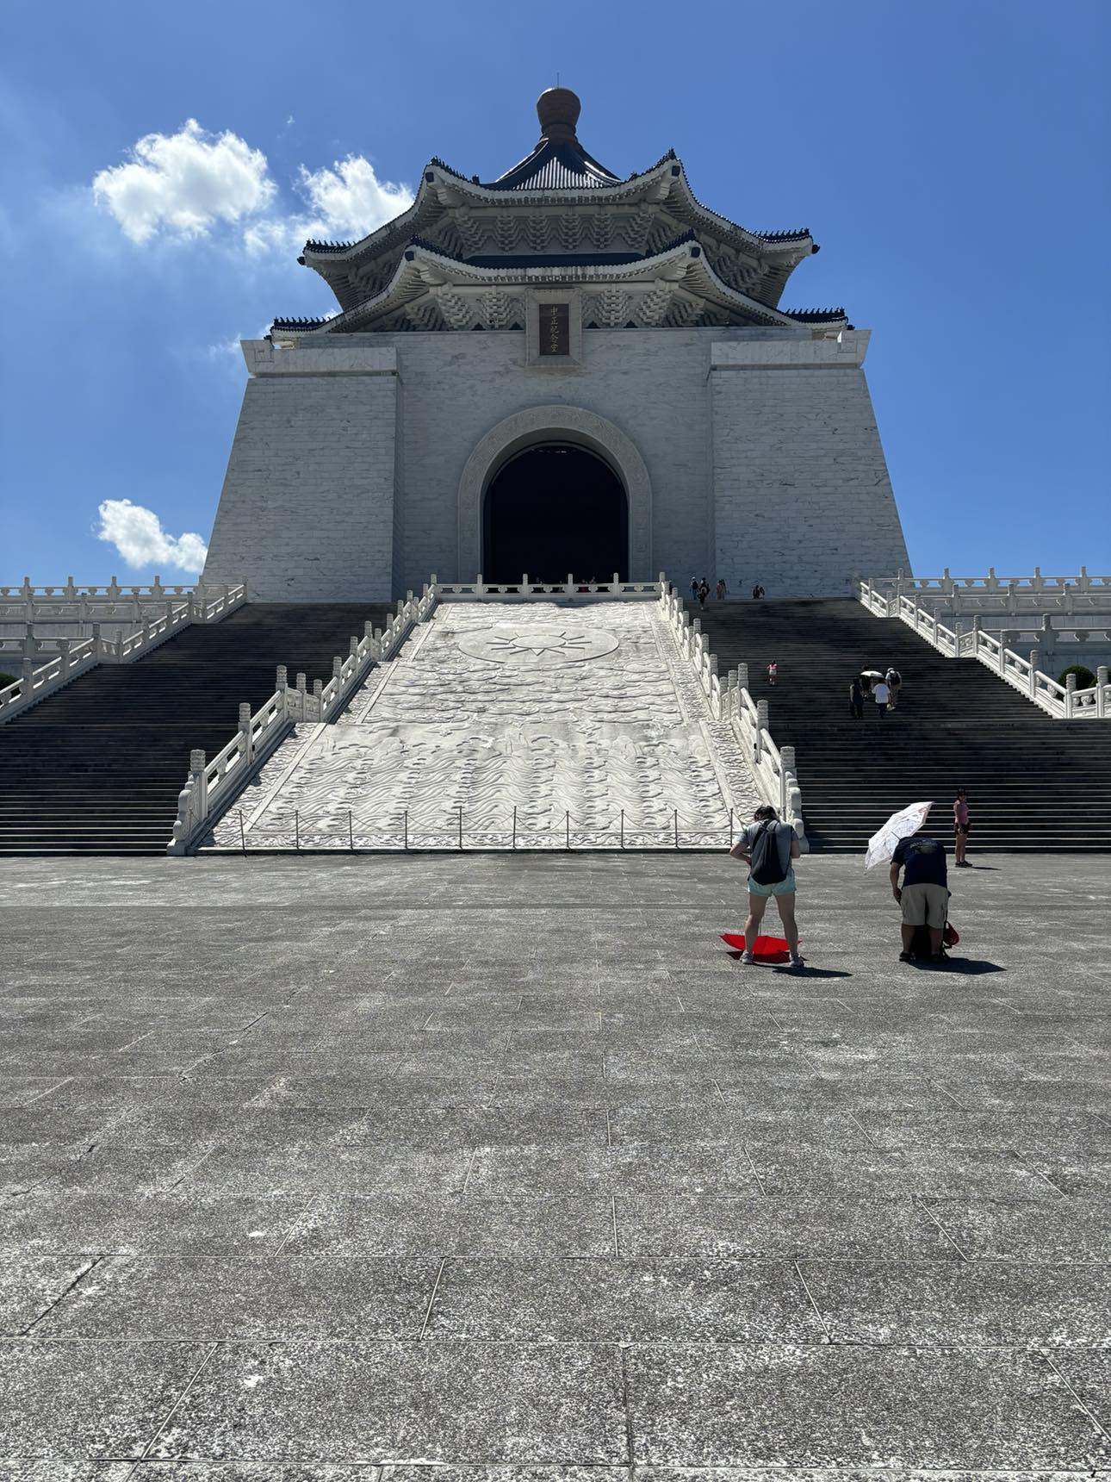
WE VISITED MANY TEMPLES SOME BUDDHISH AND TAOISM.
BUILDING WERE SYMETRICAL, FACING SOUTH, WOOD CARVING, BEUTIFULL COLORS AND INCENSE FILLED ROOMS.

Slide 8
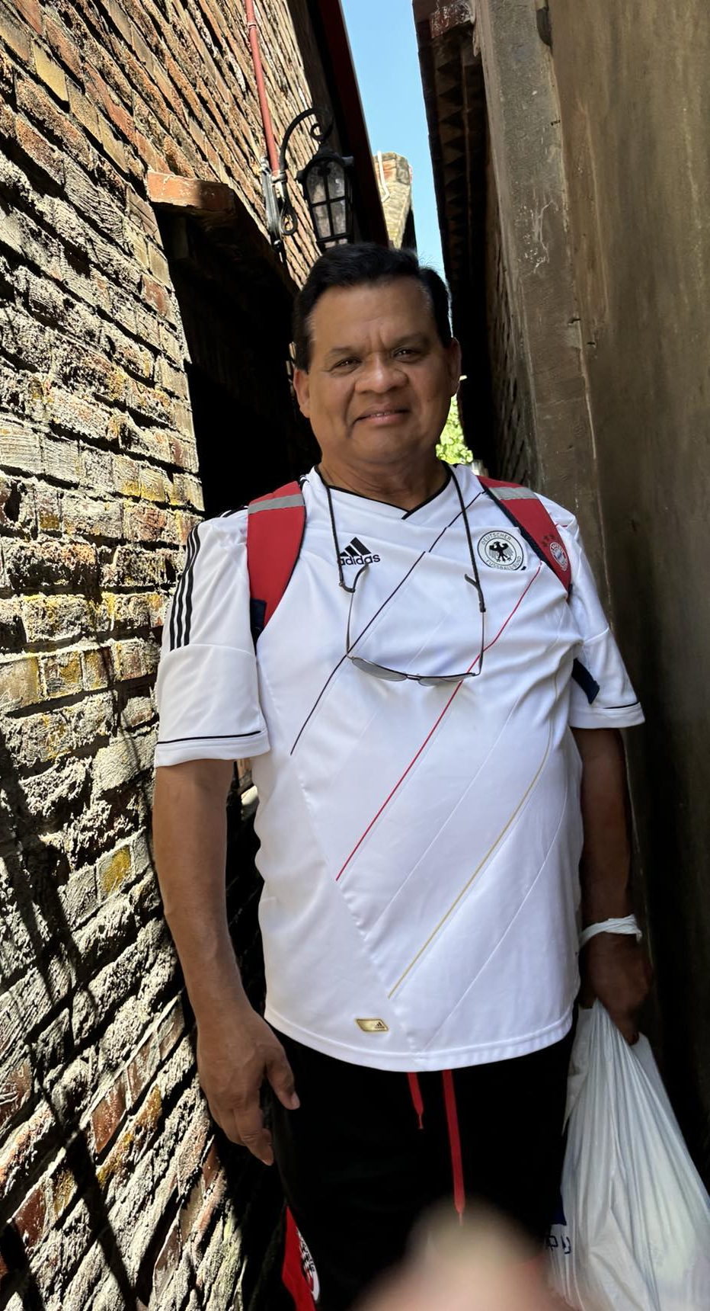
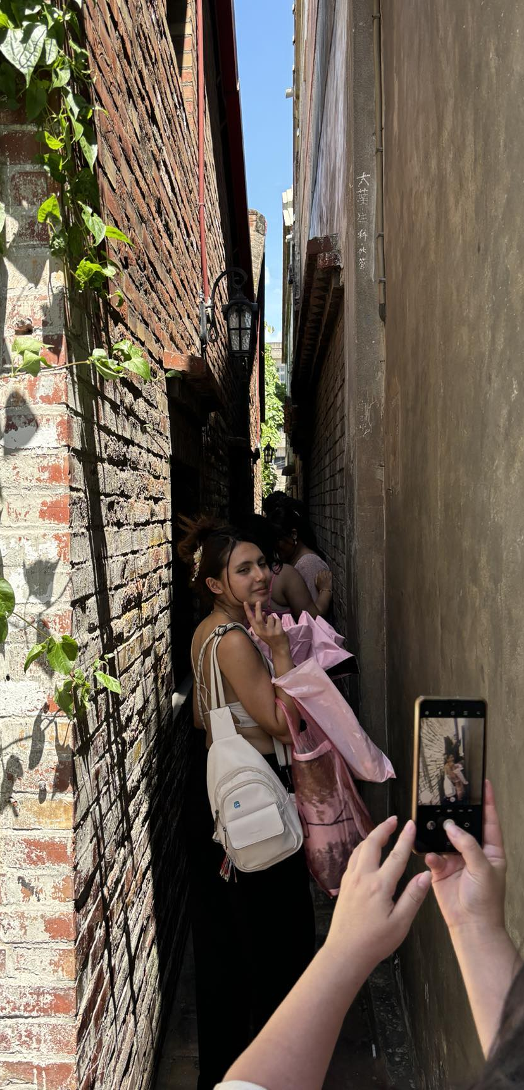
Lukang , like most pedestrian areas in Taiwan, is a great opportunity to observe “real” Taiwanese culture.
Lukang Old Street, where the past feels alive, the food is dangerously tempting, and the narrow alleys absolutely do not care about your personal space bubble.

Slide 9
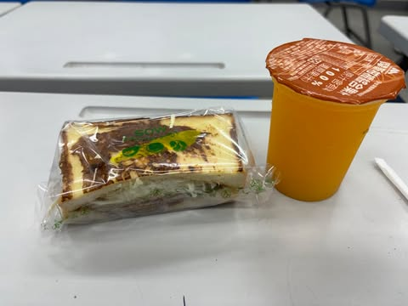
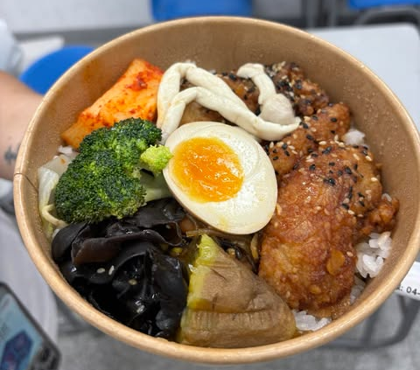
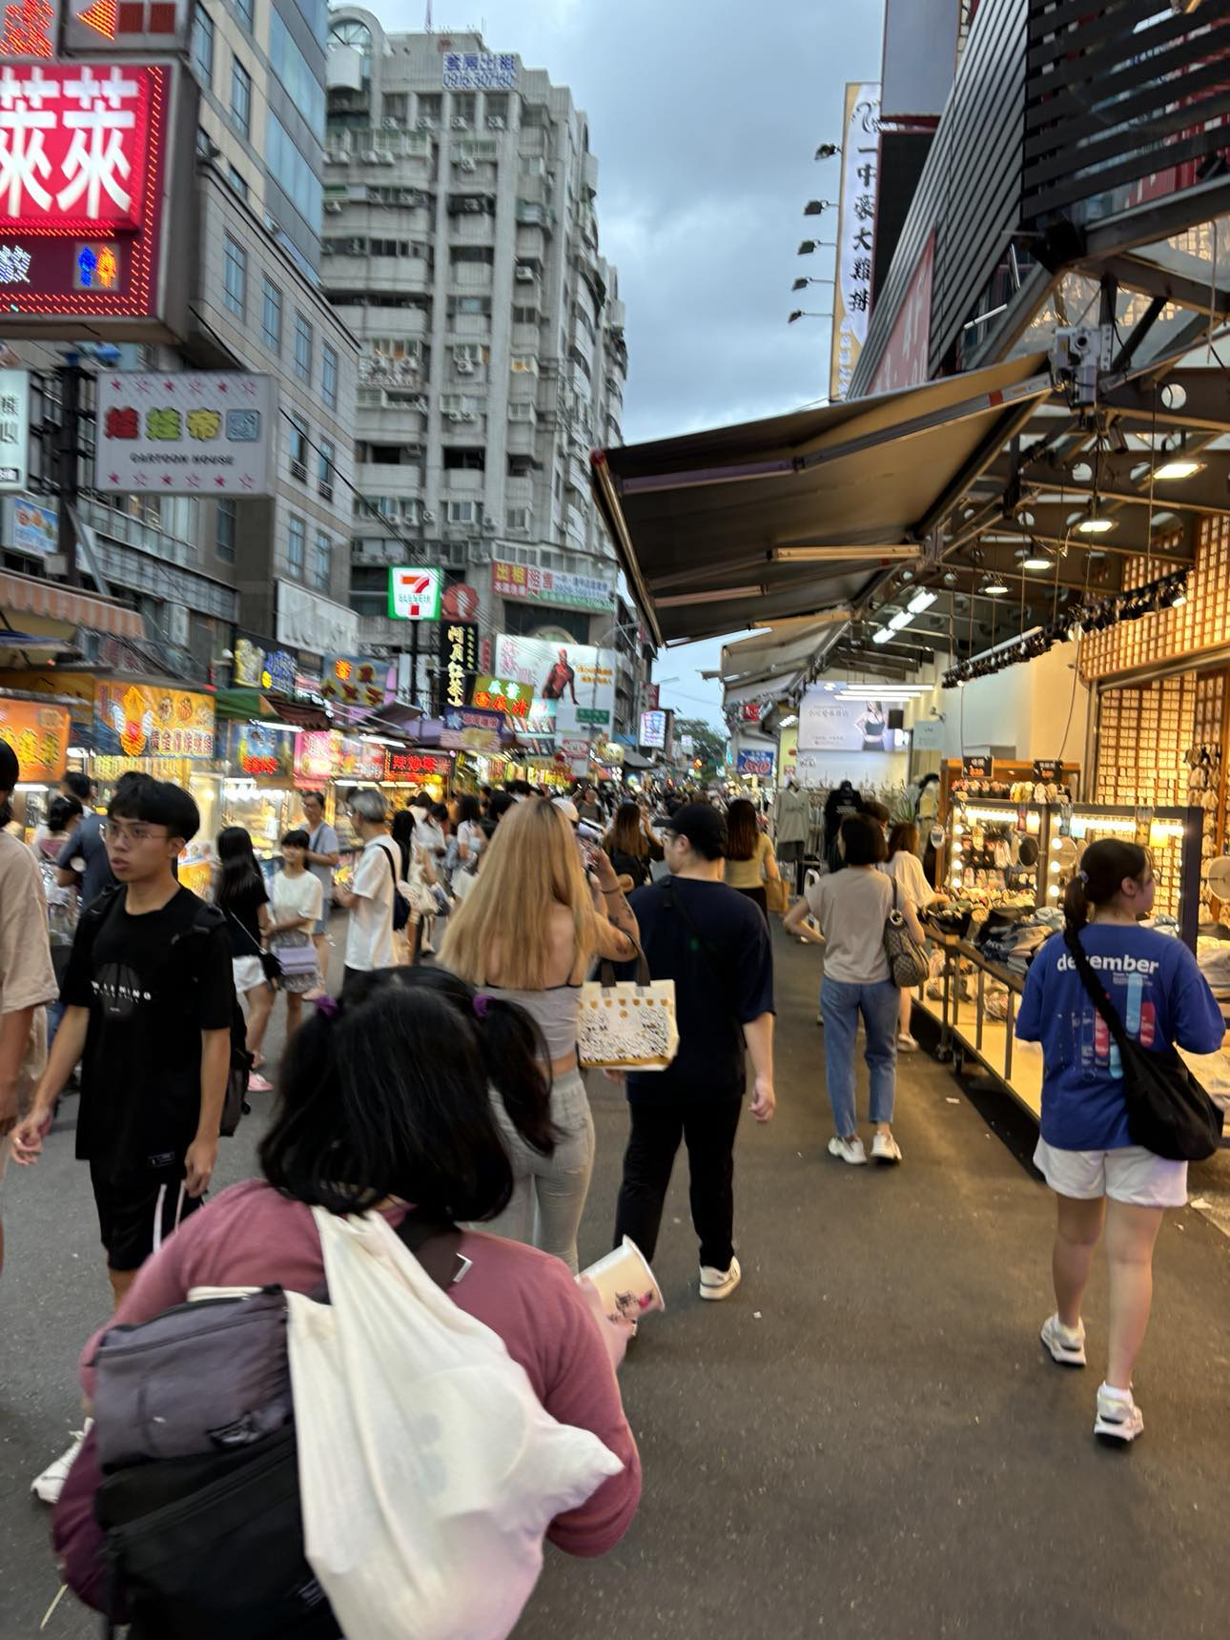
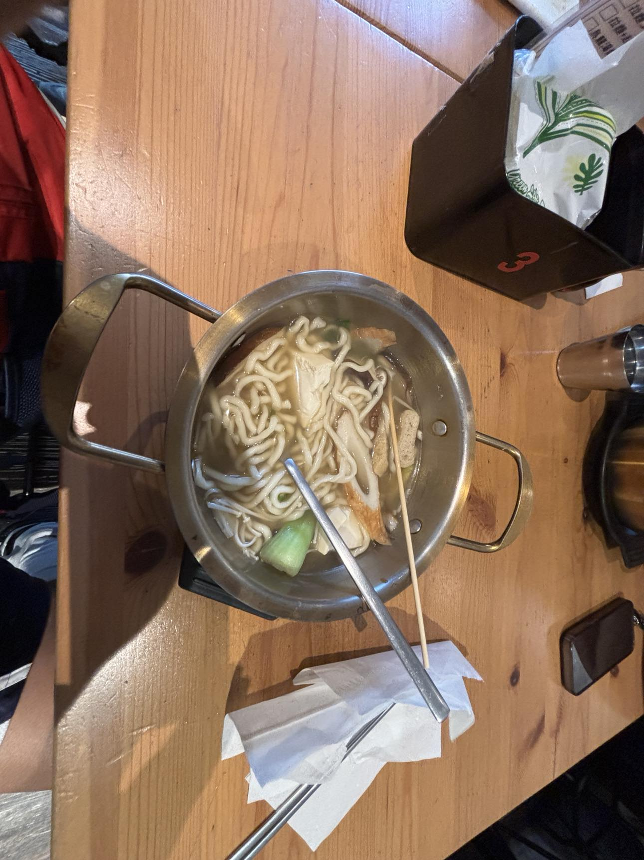
THE FOOD IN TAIWAN IS COMPLETED DIFFERENT THAN IN USA.
PORTION ARE SMALLER.
A LOT OF NOODLES AND RICE.
VERY SPICES AND MANY FLAVORS.

Slide 10
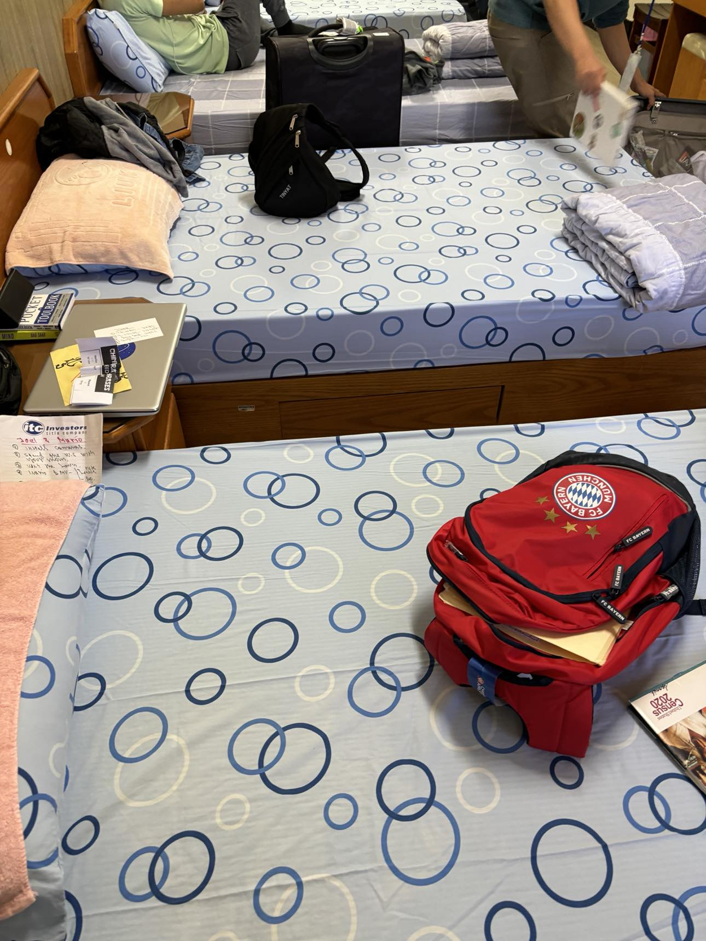
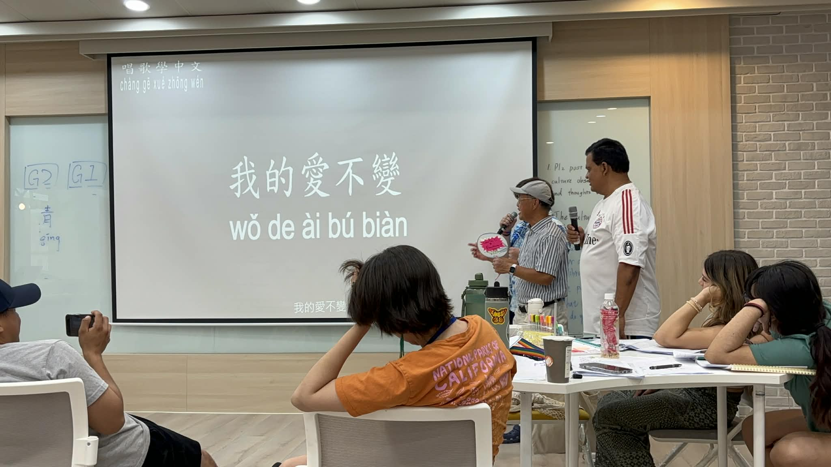
THE UNIVERSITY BUILDING ARE MODERN AND THE THEY ARE RICH IN HIGH TECH AI, FLEXIBLE PHYSICAL SPACES AND SAFE.
THE MOST IMPORTANT: AIR CONDITIONING IN ALL BUILDING AND DORMS.

